Slide 1
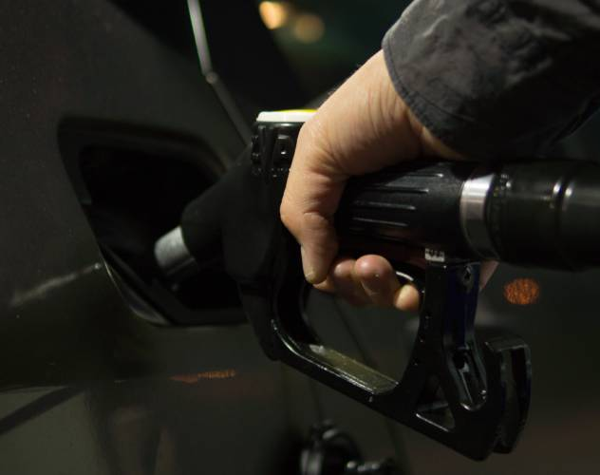
Project On: Fuel Consumption Ratings Regression
Created by:
Kuldeep Singh Shekhawat
Sachin Kanojiya
This Photo by Unknown Author is licensed under CC BY-NC-ND

Slide 2
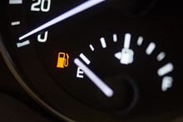

■ Importing Required Libraries ■ Importing Dataset ■ Data Preprocessing : Drop unwanted features ■ Data Visualisation ■ Data Preprocessing for Prediction ■ Prediction : Model development
STEPS OF MODEL

Slide 3
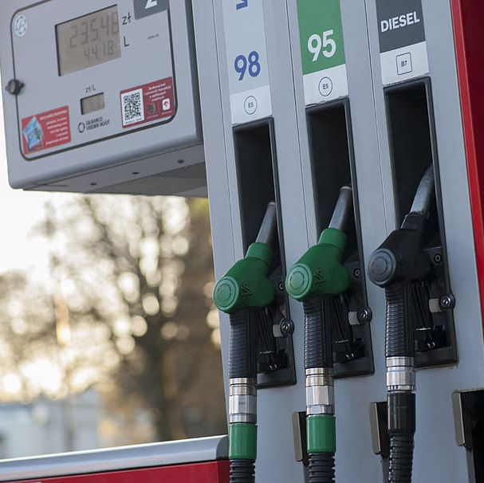
Importing Required Libraries ■ Import pandas as pd ■ import numpy as np ■ import seaborn as sns ■import matplotlib.pyplot as plt ■ %matplotlib inline ■ sns.set_style(‘darkgrid’)

Slide 4
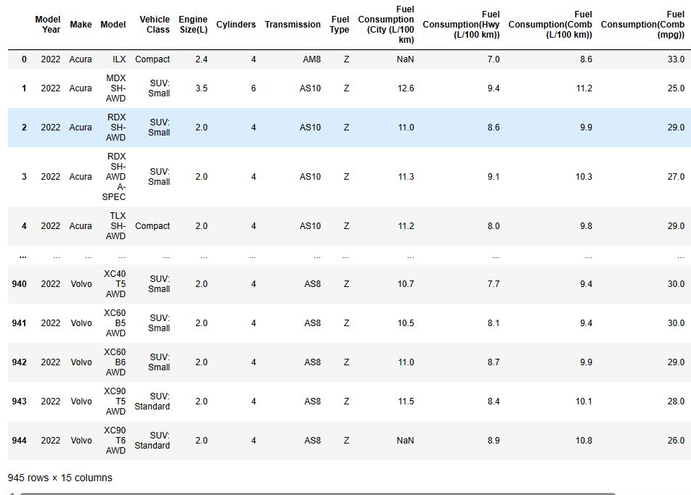
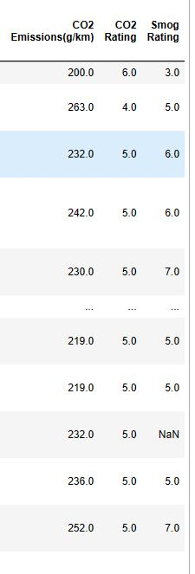
IMPORTING DATASET

Slide 5
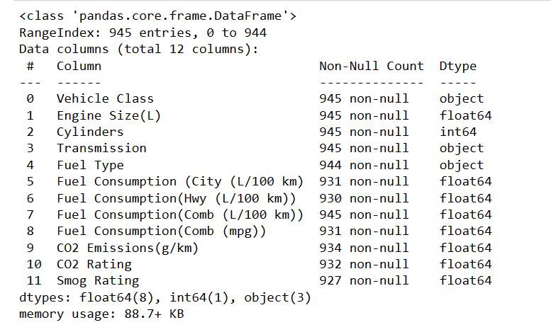
DATA INFO :

Slide 6
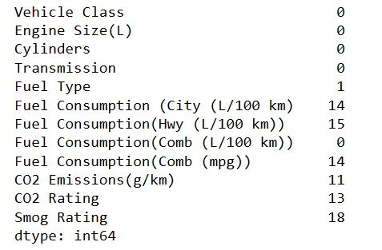
Finding Null values

Slide 7
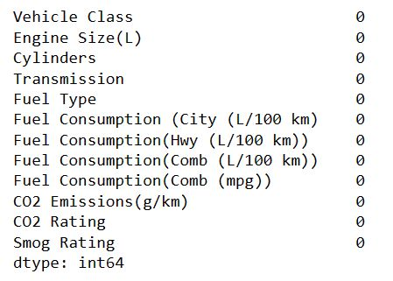
Fill Null Values

Slide 8
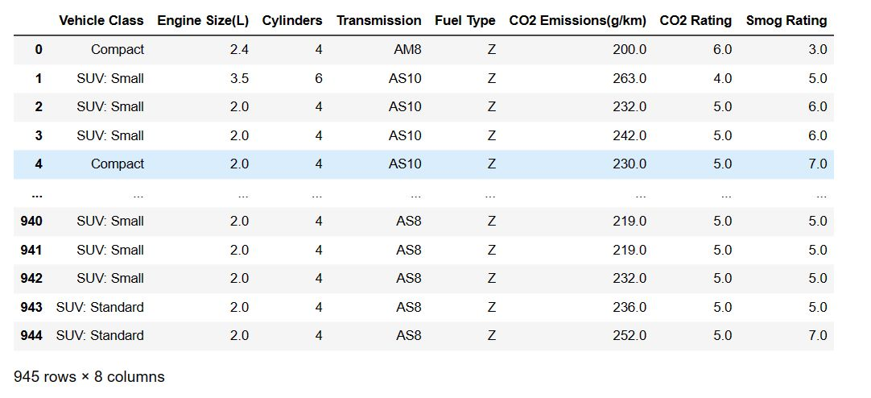
DATA PROCESSING : DROP UNWANTED FEATURES
Data preprocessing is the process of transforming raw data into anunderstandable format. It also makes the datasets more complete and efficientto perform data analysis

Slide 9
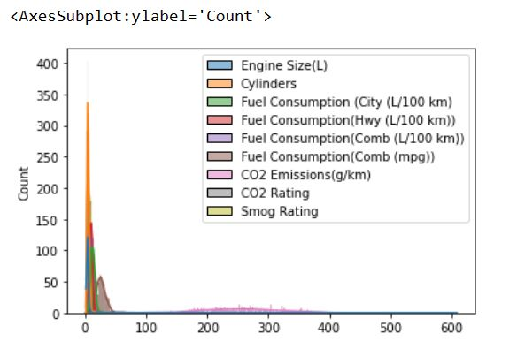
Data Visualisation HISTPLOT

Slide 10
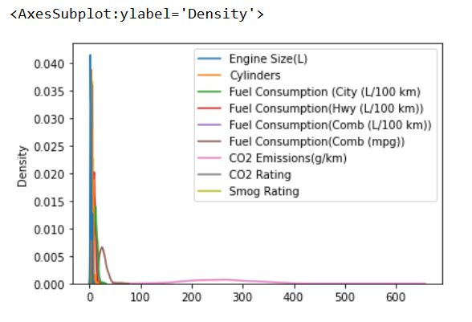
Kdeplot

Slide 11
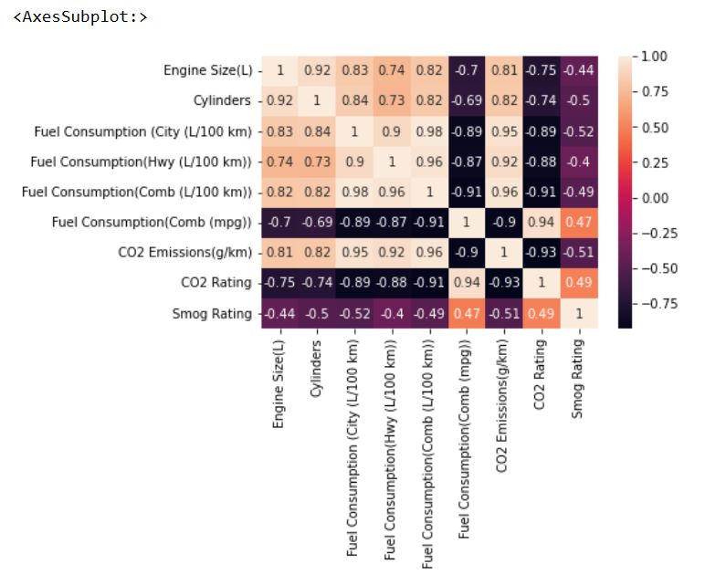
heatmap

Slide 12
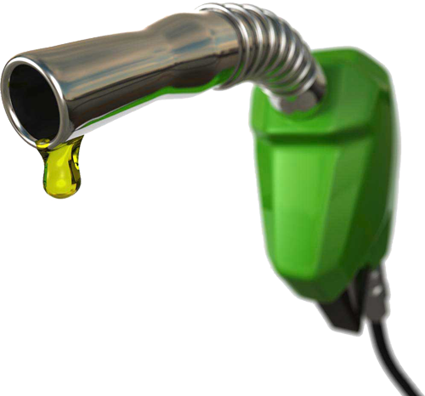
Data Preprocessing for Prediction
Before using ML model the data is processed again in 3 steps
1.Encoding categorical features 2.Splitting test & train data
3.Feature Scaling
This Photo by Unknown Author is licensed under CC BY-NC

Slide 13

Encoding
.Label Encoding refers to converting the labels into a numeric form so as to convert them into the machine readable form.We use it on our training data, and using “fit” it will figure out the unique values and assign a value to it, returns the encoded labels.
Test-Train Split The test-train split is used to estimate the performance of machine learning algorithms using training data and validate with test data
Feature scaling is a method used to normalize the range of independent variables or features of data and make them closer to each other.
This Photo by Unknown Author is licensed under CC BY-SA-NC

Slide 14

o
Logistic Regression Logistic Regression is a supervised learning algorithm that investigates the relationship b/w a dependent and independent variable and produces results in abinary format which is used to predict the out come of a categorical variable (Failue or not).
SVM Support Vector Machine(SVM) is a supervised machine learning algorithm used for both classification and regression. The algorithm creates a line or ahyperplane which separates the data into classes.
This Photo by Unknown Author is licensed under CC BY-SA

Slide 15
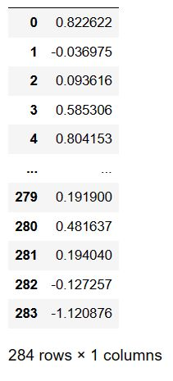
Linear Regression Model

Slide 16


